Slide 1

Air BNB Hotel Booking Analysis Project
Karne ajaykumar
STU6769283dd371a1734944829

Slide 2

PROBLEM STATEMENT
Airbnb is a popular platform where property owners rent out their homes or apartments to travelers. One of the bigger challenges for hosts is deciding the right price for their listings, since prices vary depending on several factors such the number of bedrooms, number of bathrooms, cleanliness, accuracy of descriptions, and communication quality with quests.

Slide 3
Project Description
This project focuses on buildi focuses on buliding a machine learning model te predict listings. Pricing an Airbnb property correctly is crucial h hosts price of Airtint travelers: hosts want to maximize occupancy and earnings, while travelers prices. Using historical Airbnb data, the project develops a regression model that learns and competitive relationships between listing attributes (such as number of bedrooms, bathrooms, quest ratings) and the price charged.The model can then be used to predict prices for new or hypothetical listings, helping property owner make informed pricing decisions.

Slide 4

WHO ARE THE END USERS?
Airbnb HostsTo optimize pricing of their listings based on property feat and guest reviews.-TravelersTo evaluate whether a listing is overpriced or reasonably priced.-Airbnb Platform AnalystsTo improve autogiated pricing suggestions and increase platform trust-Researchers/Students Researchers/StudentsTo study the impact of property features and reviews on rental pricing.

Slide 5

Technology Used
Core programming language-Pandas & NumPy-Data cleaning and preprocessingScikit-learn-Machine learning (model training, regression, evaluation)Matplotlib/Seaborn-lata visualization and feature importance-Google Colab-Cloud-based environment for running the projectFile handling libraries-openpyxl (for Excel) and bolt-in CV handling

Slide 6
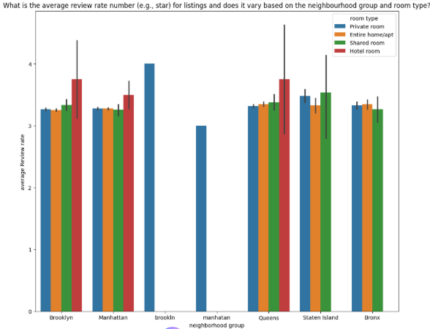
RESULTS1

Slide 7
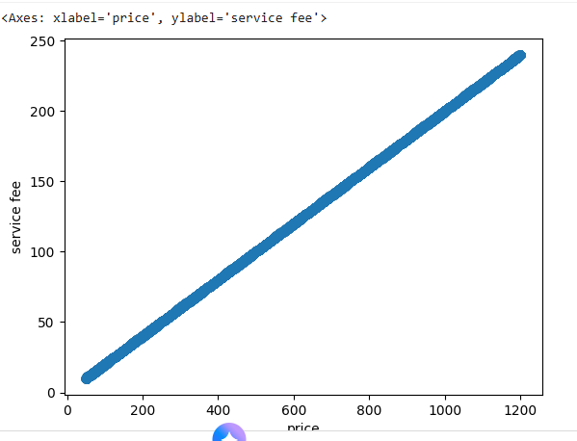
RESULTS2

Slide 8
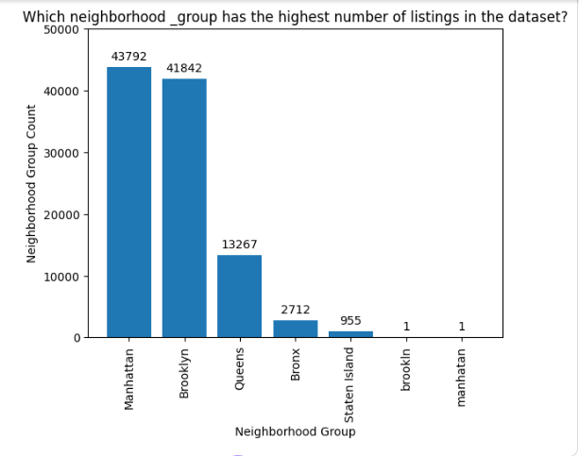
RESULTS3

Slide 9
GitHub repository
https://github.com/Karneajay1907/VOIS_AICTE_OCT2025_Karneajaykumar.git

Slide 10
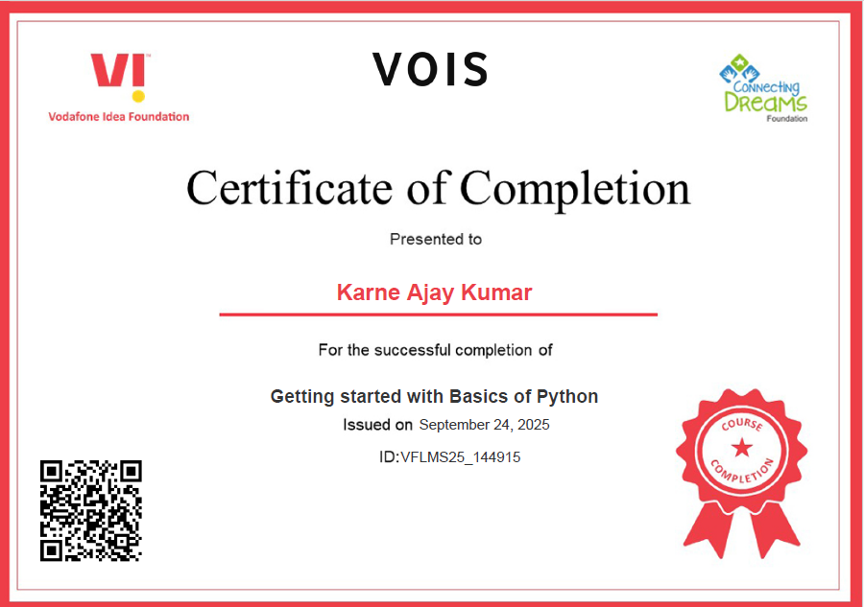
Getting started with Basics of Python Certificate

Slide 11
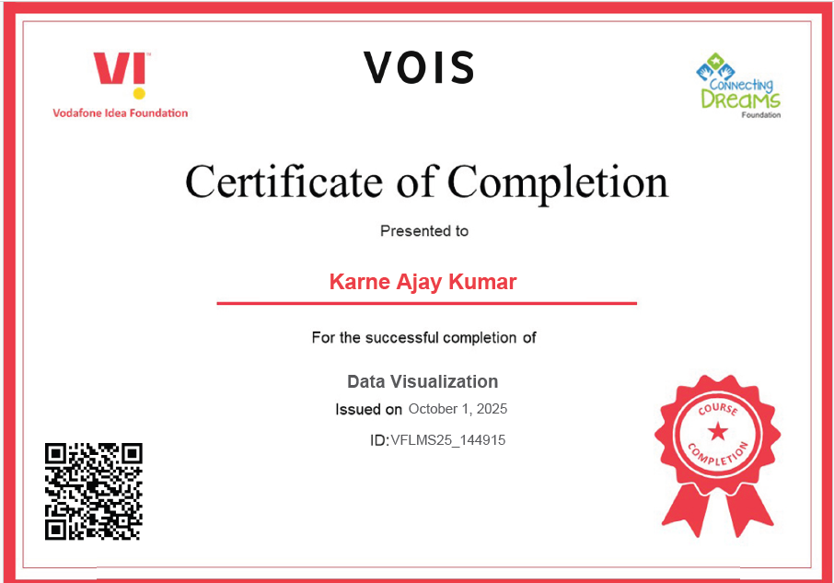
Data Visualization Certificate

Slide 12
Thank you
.
.

